Slide 1
Math Essentials
Key Source: Jeff Howbert, Intro to ML

Slide 2
Areas of math essential to machine learning
Machine learning is part of both statistics and computer science
Probability
Statistical inference
Validation
Estimates of error, confidence intervals
Linear algebra
Hugely useful for compact representation of linear transformations on data
Dimensionality reduction techniques
Optimization theory

Slide 3
Why worry about the math?
There are lots of easy-to-use machine learning packages out there.
After this course, you will know how to apply several of the most general-purpose algorithms.
HOWEVER
To get really useful results, you need good mathematical intuitions about certain general machine learning principles, as well as the inner workings of the individual algorithms.
Notes:
Put another way, it’s easy to generate garbage, harder to generate results you can have some confidence in.

Slide 4
Why worry about the math?
These intuitions will allow you to:
Choose the right algorithm(s) for the problem
Make good choices on parameter settings, validation strategies
Recognize over- or underfitting
Troubleshoot poor / ambiguous results
Put appropriate bounds of confidence / uncertainty on results
Do a better job of coding algorithms or incorporating them into more complex analysis pipelines
Notes:
Understanding uncertainty of (trained) model is critical, as it is with any statistical estimation procedure.

Slide 5
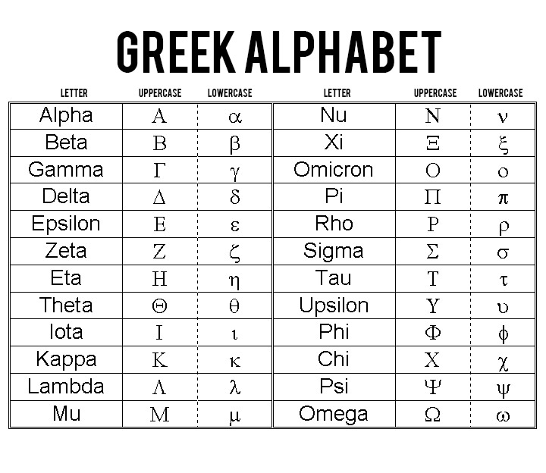
Pronunciation

Slide 6
Notation
a ∈ A set membership: a is member of set A
| B | cardinality: number of items in set B
|| v || norm: length of vector v
∑ summation
∫ integral
ℜ the set of real numbers
ℜ^{n} real number space of dimension n
n = 2 : plane or 2-space n = 3 : 3- (dimensional) space n > 3 : n-space or hyperspace

Slide 7
Notation
x, y, z, vector (bold, lower case)
u, v
A, B, X matrix (bold, upper case)
y = f( x ) function (map): assigns unique value in range of y to each value in domain of x
dy / dx derivative of y with respect to single variable x
y = f( x ) function on multiple variables, i.e. a vector of variables; function in n-space
∂y / ∂x_{i} partial derivative of y with respect to element i of vector x

Slide 8
The concept of probability
Intuition:
In some process, several outcomes are possible. When the process is repeated a large number of times, each outcome occurs with a characteristic relative frequency, or probability. If a particular outcome happens more often than another outcome, we say it is more probable.

Slide 9
The concept of probability
Arises in two contexts:
In actual repeated experiments.
Example: You record the color of 1000 cars driving by. 57 of them are green. You estimate the probability of a car being green as 57 / 1000 = 0.0057.
In idealized conceptions of a repeated process.
Example: You consider the behavior of an unbiased six-sided die. The expected probability of rolling a 5 is 1 / 6 = 0.1667.
Example: You need a model for how people’s heights are distributed. You choose a normal distribution (bell-shaped curve) to represent the expected relative probabilities.

Slide 10
Probability spaces
A probability space is a random process or experiment with three components:
Ω, the set of possible outcomes O
number of possible outcomes = | Ω | = N
F, the set of possible events E
an event comprises 0 to N outcomes
number of possible events = | F | = 2^{N}
P, the probability distribution
function mapping each outcome and event to real number between 0 and 1 (the probability of O or E)
probability of an event is sum of probabilities of possible outcomes in event

Slide 11
Axioms of probability
Non-negativity:
for any event E ∈ F, p( E ) ≥ 0
All possible outcomes:
p( Ω ) = 1
Additivity of disjoint events:
for all events E, E’ ∈ F where E ∩ E’ = ∅, p( E U E’ ) = p( E ) + p( E’ )

Slide 12
Types of probability spaces
Define | Ω | = number of possible outcomes
Discrete space | Ω | is finite
Analysis involves summations ( ∑ )
Continuous space | Ω | is infinite
Analysis involves integrals ( ∫ )

Slide 13
Example of discrete probability space
Single roll of a six-sided die
6 possible outcomes: O = 1, 2, 3, 4, 5, or 6
2⁶ = 64 possible events
example: E = ( O ∈ { 1, 3, 5 } ), i.e. outcome is odd
If die is fair, then probabilities of outcomes are equal p( 1 ) = p( 2 ) = p( 3 ) = p( 4 ) = p( 5 ) = p( 6 ) = 1 / 6
example: probability of event E = ( outcome is odd ) is p( 1 ) + p( 3 ) + p( 5 ) = 1 / 2
Notes:
Point out how the axioms of probability are obeyed.

Slide 14
Example of discrete probability space
Three consecutive flips of a coin
8 possible outcomes: O = HHH, HHT, HTH, HTT, THH, THT, TTH, TTT
2⁸ = 256 possible events
example: E = ( O ∈ { HHT, HTH, THH } ), i.e. exactly two flips are heads
example: E = ( O ∈ { THT, TTT } ), i.e. the first and third flips are tails
If coin is fair, then probabilities of outcomes are equal p( HHH ) = p( HHT ) = p( HTH ) = p( HTT ) = p( THH ) = p( THT ) = p( TTH ) = p( TTT ) = 1 / 8
example: probability of event E = ( exactly two heads ) is p( HHT ) + p( HTH ) + p( THH ) = 3 / 8

Slide 15
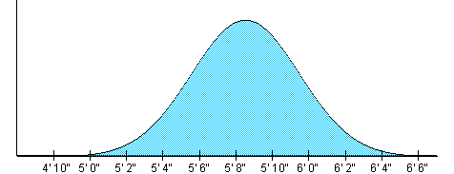
Example of continuous probability space
Height of a randomly chosen American male
Infinite number of possible outcomes: O has some single value in range 2 feet to 8 feet
Infinite number of possible events
example: E = ( O | O < 5.5 feet ), i.e. individual chosen is less than 5.5 feet tall
Probabilities of outcomes are not equal, and are described by a continuous function, p( O )

Slide 16
Example of continuous probability space
Height of a randomly chosen American male
Probabilities of outcomes O are not equal, and are described by a continuous function, p( O )
p( O ) is a relative, not an absolute probability
p( O ) for any particular O is zero
∫ p( O ) from O = -∞ to ∞ (i.e. area under curve) is 1
example: p( O = 5’8” ) > p( O = 6’2” )
example: p( O < 5’6” ) = ( ∫ p( O ) from O = -∞ to 5’6” ) ≈ 0.25
Notes:
Point out how axioms of probability are obeyed.

Slide 17
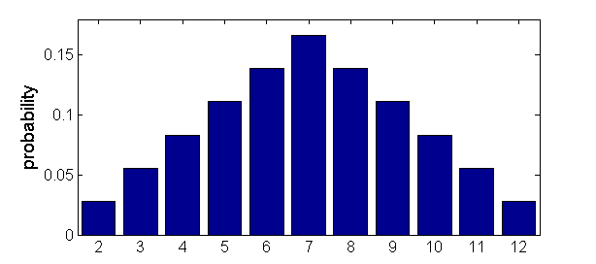
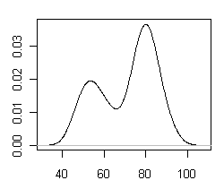
Probability distributions
Discrete: probability mass function (pmf)
example: sum of two fair dice
Continuous: probability density function (pdf)
example: waiting time between eruptions of Old Faithful (minutes)
probability

Slide 18
Random variables
A random variable X is a function that associates a number x with each outcome O of a process
Common notation: X( O ) = x, or just X = x
Basically a way to redefine (usually simplify) a probability space to a new probability space
X must obey axioms of probability (over the possible values of x)
X can be discrete or continuous
Example: X = number of heads in three flips of a coin
Possible values of X are 0, 1, 2, 3
p( X = 0 ) = p( X = 3 ) = 1 / 8 p( X = 1 ) = p( X = 2 ) = 3 / 8
Size of space (number of “outcomes”) reduced from 8 to 4
Example: X = average height of five randomly chosen American men
Size of space unchanged (X can range from 2 feet to 8 feet), but pdf of X different than for single man

Slide 19
Multivariate probability distributions
Scenario
Several random processes occur (doesn’t matter whether in parallel or in sequence)
Want to know probabilities for each possible combination of outcomes
Can describe as joint probability of several random variables
Example: two processes whose outcomes are represented by random variables X and Y. Probability that process X has outcome x and process Y has outcome y is denoted as:
p( X = x, Y = y )

Slide 20
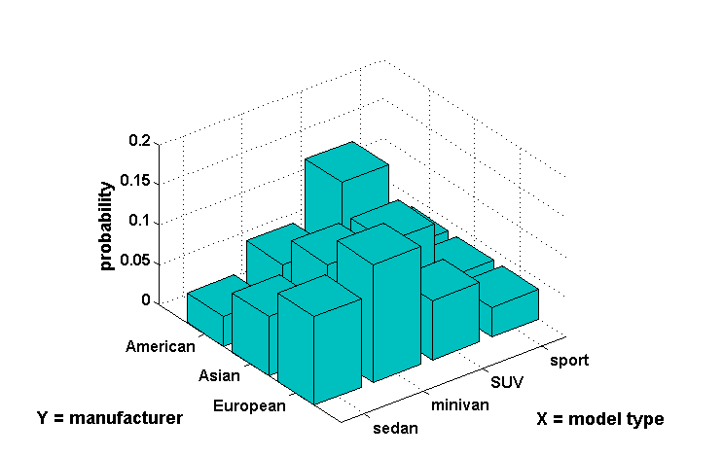
Example of multivariate distribution
joint probability: p( X = minivan, Y = European ) = 0.1481
Notes:
Discrete example

Slide 21
Multivariate probability distributions
Marginal probability
Probability distribution of a single variable in a joint distribution
Example: two random variables X and Y:
p( X = x ) = ∑_{b=all values of Y} p( X = x, Y = b )
Conditional probability
Probability distribution of one variable given that another variable takes a certain value
Example: two random variables X and Y:
p( X = x | Y = y ) = p( X = x, Y = y ) / p( Y = y )

Slide 22
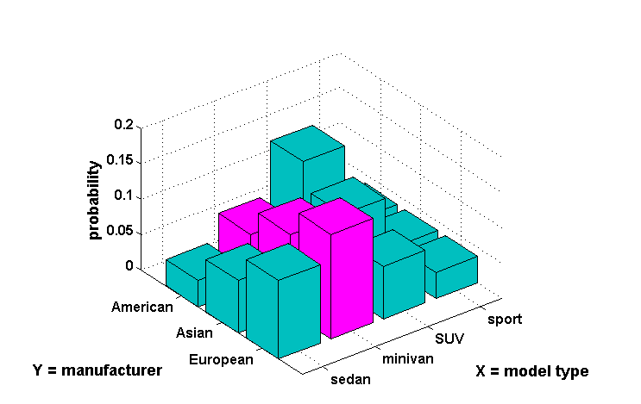
Example of marginal probability
marginal probability: p( X = minivan ) = 0.0741 + 0.1111 + 0.1481 = 0.3333

Slide 23
Example of conditional probability
conditional probability: p( Y = European | X = minivan ) =
0.1481 / ( 0.0741 + 0.1111 + 0.1481 ) = 0.4433
0.2
0.15
probability
0.1
0.05
0
American
sport
Asian
SUV
Y = manufacturer
European
minivan
X = model type
sedan

Slide 24
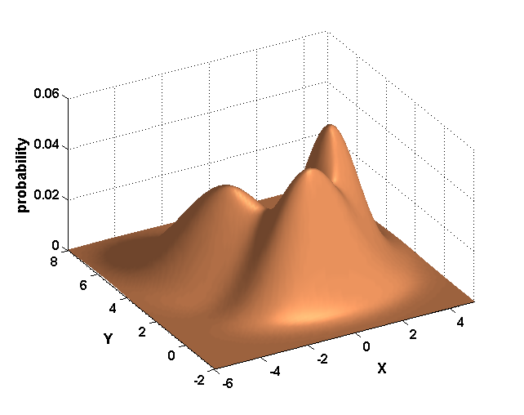
Continuous multivariate distribution
Same concepts of joint, marginal, and conditional probabilities apply (except use integrals)
Example: three-component Gaussian mixture in two dimensions
Notes:
Dimensionality in typical machine learning problems >> 2.

Slide 25
Expected value
Given:
A discrete random variable X, with possible values x = x₁, x₂, … x_{n}
Probabilities p( X = x_{i} ) that X takes on the various values of x_{i}
A function y_{i} = f( x_{i} ) defined on X
The expected value of f is the probability-weighted “average” value of f( x_{i} ):
E( f ) = ∑_{i} p( x_{i} ) ⋅ f( x_{i} )

Slide 26
Example of expected value
Process: game where one card is drawn from the deck
If face card, dealer pays you $10
If not a face card, you pay dealer $4
Random variable X = { face card, not face card }
p( face card ) = 3/13
p( not face card ) = 10/13
Function f( X ) is payout to you
f( face card ) = 10
f( not face card ) = -4
Expected value of payout is:
E( f ) = ∑_{i} p( x_{i} ) ⋅ f( x_{i} ) = 3/13 ⋅ 10 + 10/13 ⋅ -4 = -0.77

Slide 27
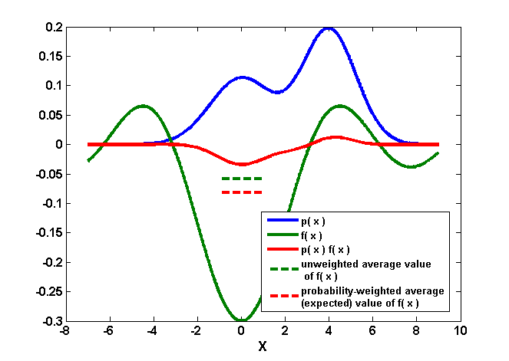
Expected value in continuous spaces
E( f ) = ∫_{x = a → b} p( x ) ⋅ f( x )

Slide 28
Common forms of expected value (1)
Mean (μ)
f( x_{i} ) = x_{i} ⇒ μ = E( f ) = ∑_{i} p( x_{i} ) ⋅ x_{i}
Average value of X = x_{i}, taking into account probability of the various x_{i}
Most common measure of “center” of a distribution
Compare to formula for mean of an actual sample
Notes:
Formulas on this slide use summation (for discrete distributions), but could as well be integration (for continuous distributions).

Slide 29
Common forms of expected value (2)
Variance (σ²)
f( x_{i} ) = ( x_{i} - μ ) ⇒ σ² = ∑_{i} p( x_{i} ) ⋅ ( x_{i} - μ )²
Average value of squared deviation of X = x_{i} from mean μ, taking into account probability of the various x_{i}
Most common measure of “spread” of a distribution
σ is the standard deviation
Compare to formula for variance of an actual sample
Notes:
Formulas on this slide use summation (for discrete distributions), but could as well be integration (for continuous distributions).

Slide 30
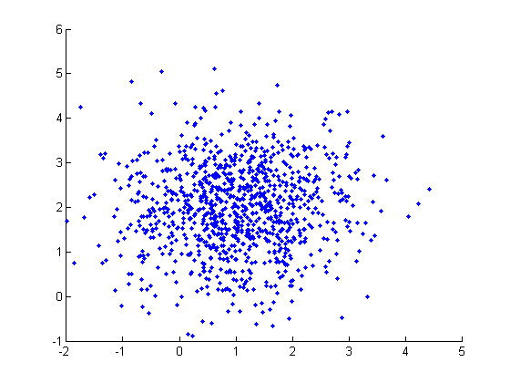
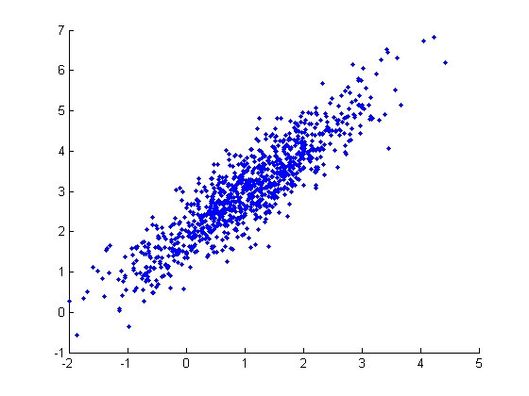
Common forms of expected value (3)
Covariance
f( x_{i} ) = ( x_{i} - μ_{x} ), g( y_{i} ) = ( y_{i} - μ_{y} ) ⇒ cov( x, y ) = ∑_{i} p( x_{i} , y_{i} ) ⋅ ( x_{i} - μ_{x} ) ⋅ ( y_{i} - μ_{y} )
Measures tendency for x and y to deviate from their means in same (or opposite) directions at same time
Compare to formula for covariance of actual samples
no covariance
high (positive)
covariance
Notes:
This is expected value of two random variables considered simultaneously.
When working in higher-dimensional spaces, can have a whole matrix of covariances (will look at later).
Formulas on this slide use summation (for discrete distributions), but could as well be integration (for continuous distributions).

Slide 31
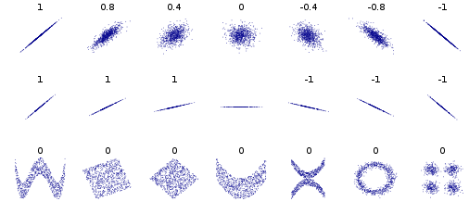
Correlation
Pearson’s correlation coefficient is covariance normalized by the standard deviations of the two variables
Always lies in range -1 to 1
Only reflects linear dependence between variables
Linear dependence with noise
Linear dependence without noise
Various nonlinear dependencies

Slide 32
Complement rule
Given: event A, which can occur or not
p( not A ) = 1 - p( A )
Ω
A
not A
areas represent relative probabilities
Notes:
Same expression given previously to define conditional probability.
Example of two events which can co-occur (or not): flips of two coins.

Slide 33
Product rule
Given: events A and B, which can co-occur (or not)
p( A, B ) = p( A | B ) ⋅ p( B )
(same expression given previously to define conditional probability)
(not A, not B)
A
B
( A, B )
Ω
(A, not B)
(not A, B)
areas represent relative probabilities
Notes:
Same expression given previously to define conditional probability.
Example of two events which can co-occur (or not): flips of two coins.

Slide 34
Example of product rule
Probability that a man has white hair (event A) and is over 65 (event B)
p( B ) = 0.18
p( A | B ) = 0.78
p( A, B ) = p( A | B ) ⋅ p( B ) = 0.78 ⋅ 0.18 = 0.14

Slide 35
Rule of total probability
Given: events A and B, which can co-occur (or not)
p( A ) = p( A, B ) + p( A, not B )
(same expression given previously to define marginal probability)
(not A, not B)
A
B
( A, B )
Ω
(A, not B)
(not A, B)
areas represent relative probabilities
Notes:
Same expression given previously to define marginal probability.
Also known as sum rule.

Slide 36
Independence
Given: events A and B, which can co-occur (or not)
p( A | B ) = p( A ) or p( A, B ) = p( A ) ⋅ p( B )
Ω
(not A, not B)
(not A, B)
B
(A, not B)
A
( A, B )
areas represent relative probabilities
Notes:
Same expression given previously to define conditional probability.
Example of two events which can co-occur (or not): flips of two coins.

Slide 37
Examples of independence / dependence
Independence:
Outcomes on multiple rolls of a die
Outcomes on multiple flips of a coin
Height of two unrelated individuals
Probability of getting a king on successive draws from a deck, if card from each draw is replaced
Dependence:
Height of two related individuals
Duration of successive eruptions of Old Faithful
Probability of getting a king on successive draws from a deck, if card from each draw is not replaced

Slide 38
Example of independence vs. dependence
Independence: All manufacturers have identical product mix. p( X = x | Y = y ) = p( X = x ).
Dependence: American manufacturers love SUVs, Europeans manufacturers don’t.

Slide 39
Bayes rule
A way to find conditional probabilities for one variable when conditional probabilities for another variable are known.
p( B | A ) = p( A | B ) ⋅ p( B ) / p( A )
where p( A ) = p( A, B ) + p( A, not B )
(not A, not B)
A
B
( A, B )
Ω
(A, not B)
(not A, B)
Notes:
Combine product rule and rule of total probability.

Slide 40
Bayes rule
posterior probability ∝ likelihood × prior probability
p( B | A ) = p( A | B ) ⋅ p( B ) / p( A )
(not A, not B)
A
B
( A, B )
Ω
(A, not B)
(not A, B)
Notes:
Combine product and sum rules.

Slide 41
Example of Bayes rule
Marie is getting married tomorrow at an outdoor ceremony in the desert. In recent years, it has rained only 5 days each year. Unfortunately, the weatherman is forecasting rain for tomorrow. When it actually rains, the weatherman has forecast rain 90% of the time. When it doesn't rain, he has forecast rain 10% of the time. What is the probability it will rain on the day of Marie's wedding?
Event A: The weatherman has forecast rain.
Event B: It rains.
We know:
p( B ) = 5 / 365 = 0.0137 [ It rains 5 days out of the year. ]
p( not B ) = 360 / 365 = 0.9863
p( A | B ) = 0.9 [ When it rains, the weatherman has forecast rain 90% of the time. ]
p( A | not B ) = 0.1 [When it does not rain, the weatherman has forecast rain 10% of the time.]

Slide 42
Example of Bayes rule, cont’d.
We want to know p( B | A ), the probability it will rain on the day of Marie's wedding, given a forecast for rain by the weatherman. The answer can be determined from Bayes rule:
p( B | A ) = p( A | B ) ⋅ p( B ) / p( A )
p( A ) = p( A | B ) ⋅ p( B ) + p( A | not B ) ⋅ p( not B ) = (0.9)(0.014) + (0.1)(0.986) = 0.111
p( B | A ) = (0.9)(0.0137) / 0.111 = 0.111
The result seems unintuitive but is correct. Even when the weatherman predicts rain, it only rains only about 11% of the time. Despite the weatherman's gloomy prediction, it is unlikely Marie will get rained on at her wedding.

Slide 43
Probabilities: when to add, when to multiply
ADD: When you want to allow for occurrence of any of several possible outcomes of a single process. Comparable to logical OR.
MULTIPLY: When you want to allow for simultaneous occurrence of particular outcomes from more than one process. Comparable to logical AND.
But only if the processes are independent.

Slide 44
Linear algebra applications
Operations on or between vectors and matrices
Coordinate transformations
Dimensionality reduction
Linear regression
Solution of linear systems of equations
Many others
Applications 1) – 4) are directly relevant to this course. Today we’ll start with 1).

Slide 45
Why vectors and matrices?
Most common form of data organization for machine learning is a 2D array, where
rows represent samples (records, items, datapoints)
columns represent attributes (features, variables)
Natural to think of each sample as a vector of attributes, and whole array as a matrix
vector
matrix

Slide 46
Vectors
Definition: an n-tuple of values (usually real numbers).
n referred to as the dimension of the vector
n can be any positive integer, from 1 to infinity
Can be written in column form or row form
Column form is conventional
Vector elements referenced by subscript

Slide 47
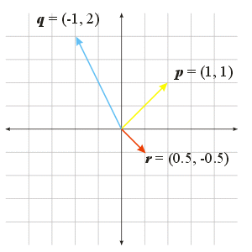
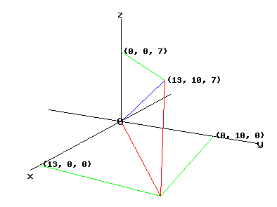
Vectors
Can think of a vector as:
a point in space or
a directed line segment with a magnitude and direction

Slide 48
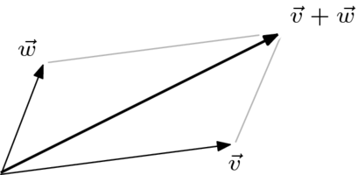
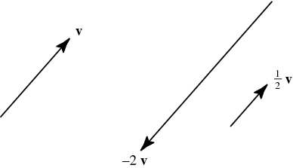
Vector arithmetic
Addition of two vectors
add corresponding elements
result is a vector
Scalar multiplication of a vector
multiply each element by scalar
result is a vector

Slide 49
Vector arithmetic
Dot product of two vectors
multiply corresponding elements, then add products
result is a scalar
Dot product alternative form
y
θ
x

Slide 50
Matrices
Definition: an m x n two-dimensional array of values (usually real numbers).
m rows
n columns
Matrix referenced by two-element subscript
first element in subscript is row
second element in subscript is column
example: A₂₄ or a₂₄ is element in second row, fourth column of A

Slide 51
Matrices
A vector can be regarded as special case of a matrix, where one of matrix dimensions = 1.
Matrix transpose (denoted ^{T})
swap columns and rows
row 1 becomes column 1, etc.
m x n matrix becomes n x m matrix
example:
Notes:
DON’T think of transpose as just turning the matrix on its side. Need to think of as flip about diagonal running from upper left to lower right.

Slide 52
Matrix arithmetic
Addition of two matrices
matrices must be same size
add corresponding elements: c_{ij} = a_{ij} + b_{ij}
result is a matrix of same size
Scalar multiplication of a matrix
multiply each element by scalar: b_{ij} = d ⋅ a_{ij}
result is a matrix of same size

Slide 53
Matrix arithmetic
Matrix-matrix multiplication
vector-matrix multiplication just a special case
TO THE BOARD!!
Multiplication is associative
A ⋅ ( B ⋅ C ) = ( A ⋅ B ) ⋅ C
Multiplication is not commutative A ⋅ B ≠ B ⋅ A (generally)
Transposition rule: ( A ⋅ B )^{T} = B ^{T} ⋅ A ^{T}

Slide 54
Matrix arithmetic
RULE: In any chain of matrix multiplications, the column dimension of one matrix in the chain must match the row dimension of the following matrix in the chain.
Examples
A 3 x 5 B 5 x 5 C 3 x 1
Right:
A ⋅ B ⋅ A^{T} C^{T} ⋅ A ⋅ B A^{T} ⋅ A ⋅ B C ⋅ C^{T} ⋅ A
Wrong:
A ⋅ B ⋅ A C ⋅ A ⋅ B A ⋅ A^{T} ⋅ B C^{T} ⋅ C ⋅ A

Slide 55
Vector projection
Orthogonal projection of y onto x
Can take place in any space of dimensionality > 2
Unit vector in direction of x is x / || x ||
Length of projection of y in direction of x is || y || ⋅ cos(θ )
Orthogonal projection of y onto x is the vector proj_{x}( y ) = x ⋅ || y || ⋅ cos(θ ) / || x || = [ ( x ⋅ y ) / || x ||² ] x (using dot product alternate form)
y
θ
x
proj_{x}( y )

